Slide 1

Solving an SDG Problem with Data
Mbuso Mulaudzi
This Photo by Unknown Author is licensed under CC BY-NC

Slide 2

Agenda
Project overview and SDG alignment.
Problem definition and significance.
Database design and schema.
Data analysis insights.
Excel dashboard demonstration.

Slide 3


Climate Action (Project overview and SDG alignment)
Climate change is leading to an increase in the frequency and intensity of extreme weather events such as heatwaves, droughts, floods, and tropical cyclones. These events have severe impacts on various sectors, including agriculture, water management, health, and infrastructure, thereby threatening food security, health, and overall community resilience.
Addressing the problem of increasing extreme weather events through data-driven approaches can significantly contribute to achieving SDG 13
This Photo by Unknown Author is licensed under CC BY-SA-NC
This Photo by Unknown Author is licensed under CC BY-NC

Slide 4

Problem definition and significance
Data Utilization
Historical Climate Data: Analyzing historical climate data to identify trends in extreme weather events over the past decades can help in understanding the correlation between climate change and the increasing frequency of these events.
Impact Assessment: Collecting and analyzing data on the economic and social impacts of extreme weather events can provide insights into the vulnerabilities of different regions and populations. This includes data on agricultural losses, health impacts, and infrastructure damage.
Predictive Modeling: Utilizing predictive models that incorporate climate data, land use, and socio-economic factors can help forecast future extreme weather events and their potential impacts. This can aid in developing adaptive strategies and disaster preparedness plans.
Resilience Metrics: Developing metrics to measure community resilience to climate-related hazards can help in assessing the effectiveness of current policies and interventions aimed at building resilience. This includes data on infrastructure robustness, emergency response capabilities, and community awareness.
Policy Evaluation: Analyzing data on the implementation and effectiveness of climate policies and adaptation strategies can provide insights into what measures are working and where improvements are needed. This can be linked to targets under SDG 13, such as integrating climate measures into national policies (Target 13.2) and improving education and awareness (Target 13.3).

Slide 5
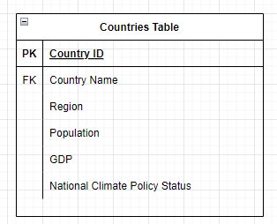
Database design and schema
ERD DESIGN
SQL
CREATE TABLE Countries (
CountryID INT PRIMARY KEY,
CountryName VARCHAR(100),
Region VARCHAR(50),
Population BIGINT,
GDP DECIMAL(15,2),
NationalClimatePolicyStatus VARCHAR(100)
);

Slide 6
Data analysis insights
Retrieve All Countries with Their GDP and Population
SELECT CountryID, CountryName, Population, GDP
FROM Countries;
Calculate Average GDP of Countries with Adopted Climate Policies
SELECT AVG(GDP) AS AverageGDP
FROM Countries
WHERE NationalClimatePolicyStatus = 'Adopted';

Slide 7
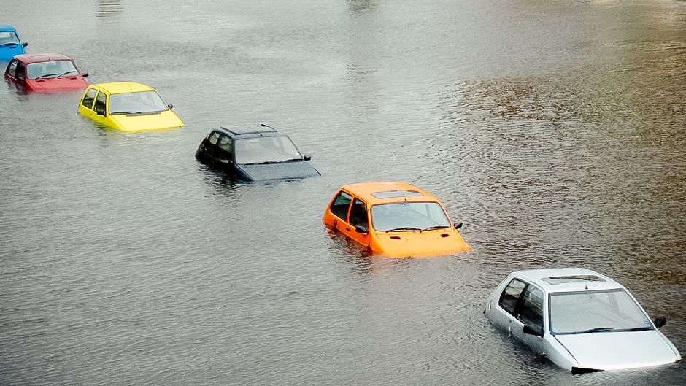
Excel dashboard demonstration
This Photo by Unknown Author is licensed under CC BY-SA-NC

Slide 8
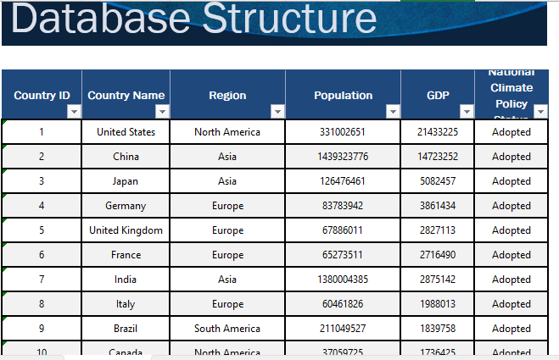
Excel dashboard demonstration.

Slide 9



Summary
insights into the demographics, economic status, and climate policy commitments of various countries. It emphasizes the importance of ongoing efforts to monitor and enhance climate policies to mitigate the impacts of climate change effectively. As countries strive to meet their climate goals, the data can serve as a foundation for further analysis and policy development.
This Photo by Unknown Author is licensed under CC BY-SA

Slide 10
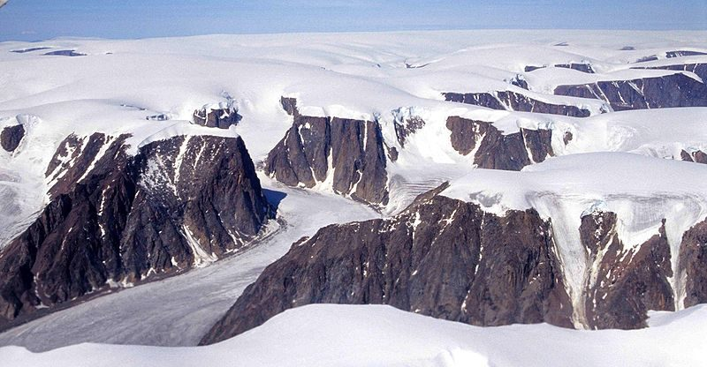

THANK YOU

